Slide 1
R Shiny Investigative Tool User Guide
Exploratory Data Analysis
Locations for Exploration 2
Transactions for Exploration 3
Individual Card Transactions 5
Employees of GASTech 7
Email Correspondence 8
Inferential Statistics
Email Network Analysis 9
Networks 10
Employee Movement Plot 14
Transaction Amount Analysis 15

Slide 2
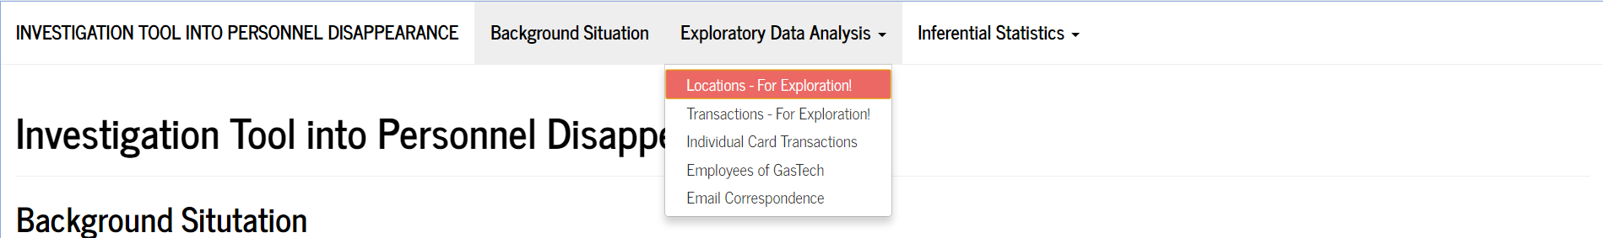
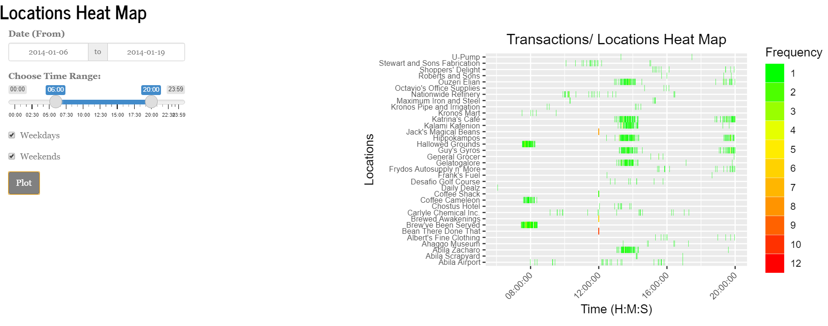
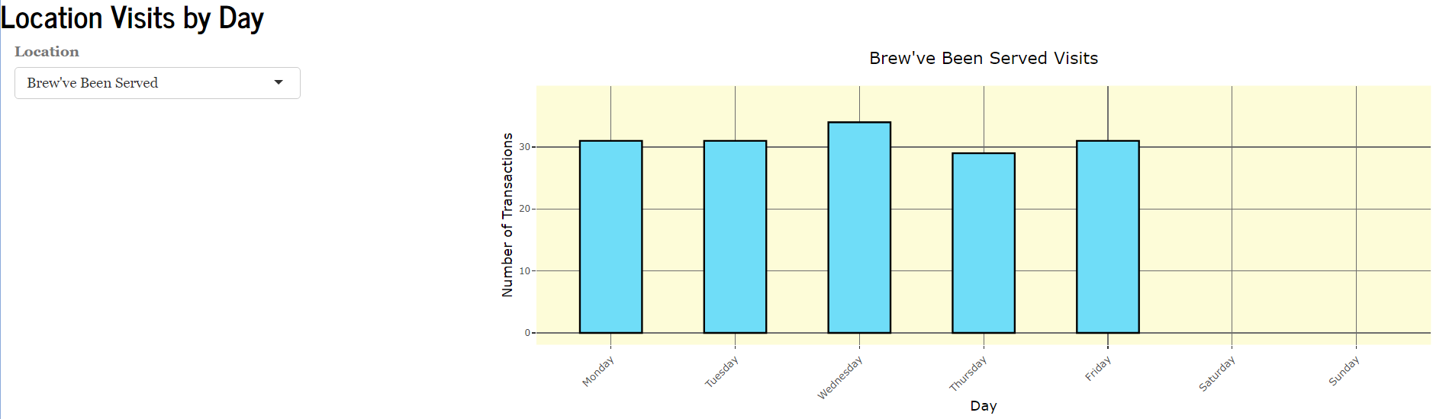
Locations for Exploration :: EDA
Under the tab Exploratory Data Analysis, select Locations – For Exploration!
1
2
3
4
5
[1] Select the range of dates for all the transactions.
[2] Select the time range for the day to explore.
[3] Could toggle between Weekdays, Weekends or both.
[4] Push the “Plot” button and the heatmap would appear.
[5] Select the location to explore, and the transactions for each day would be plotted on the right, inferring their operating days of the week.

Slide 3
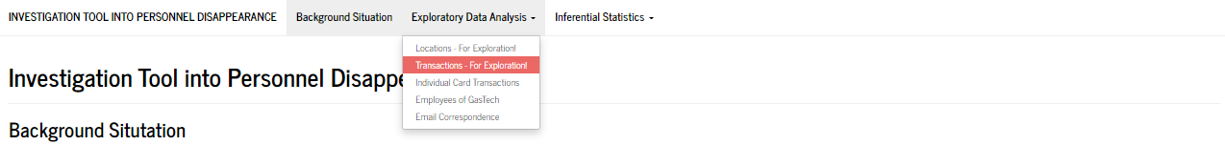
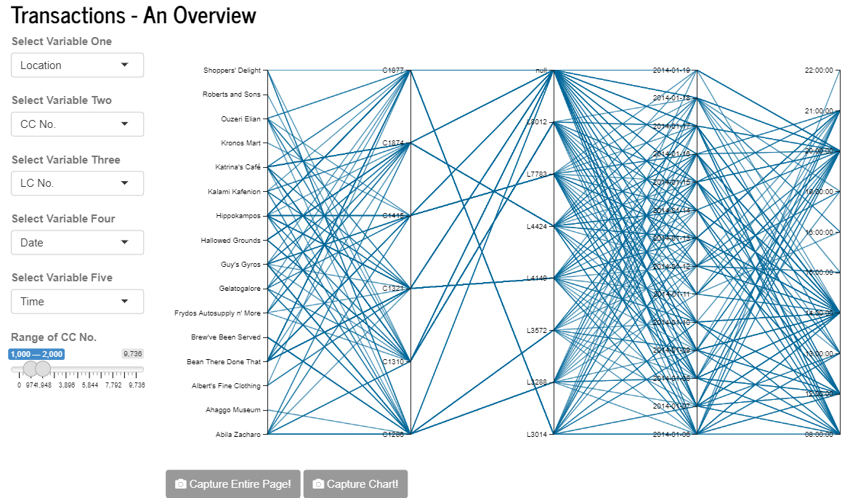
Transactions for Exploration :: EDA
Under the tab Exploratory Data Analysis, select Transactions – For Exploration!
Parallel Coordinate Plots are useful charts for visualizing multivariate numerical data. They are ideal for comparing multiple variables at one go and to display the relationships between them. You will notice that each variable is given its own axis, and all axes are placed parallel to each other. Each observation is represented by a series of lines which connect across corresponding values across all axes.
1
4
2
3
[1] Select the Variables to visualize the relationships for. Variable One would be placed on the leftmost axis, Variable Five on the rightmost axis.
[2] Drag the slider to select the range of credit card numbers you would like the chart to display. There are 54 unique credit card numbers. Viewing by filtered ranges would allow you to view the lines, and thus the relationships, more clearly.
[3] Screenshot buttons are provided for you to save your plots conveniently with one click, be it to compare later or include in a report.
[4] The output plot is interactive. Hover over the plot till a crosshair appears, draw a rectangle over the range of variables you would like to see all connected lines for. You may also slide this grey box up and down the axis, connected lines (together with all their associations) which are within the range of this grey box would appear. Note that you can draw multiple boxes across variables and boxes are also resizable.

Slide 4
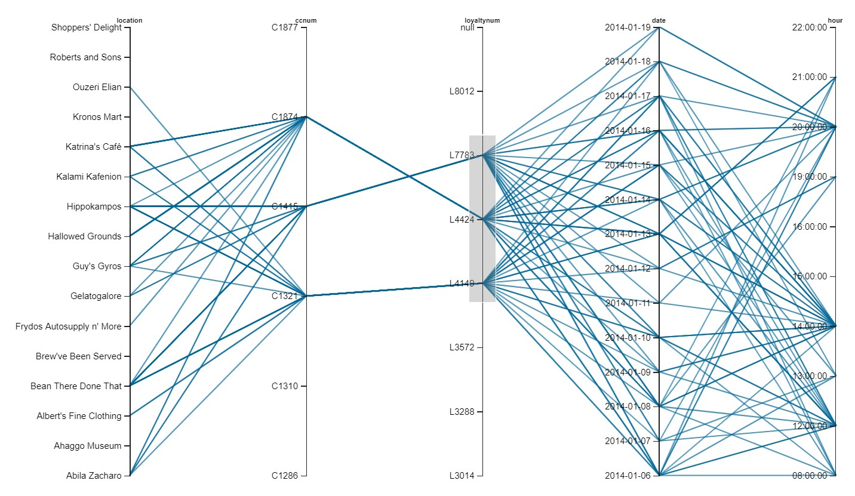
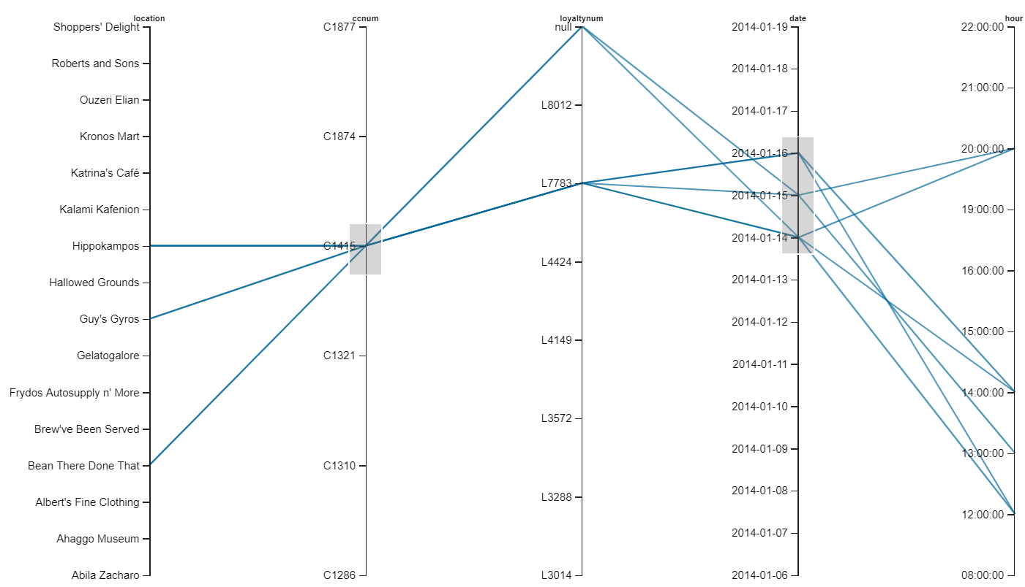
For e.g. you may wish to see which credit cards have transactions for the date period of 12th – 14th Jan -> Draw one grey box over 12th and 14th Jan, and another one over one credit card number. Slide the grey box on the credit card number axis and see all the connections appear and change.

Slide 5
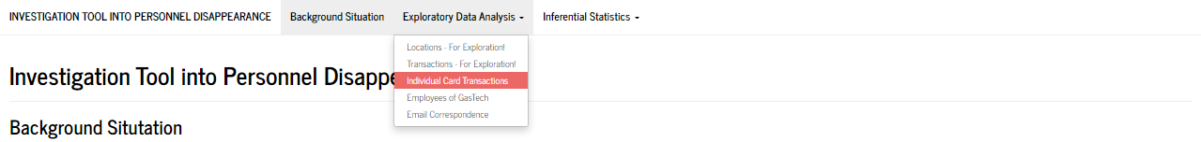
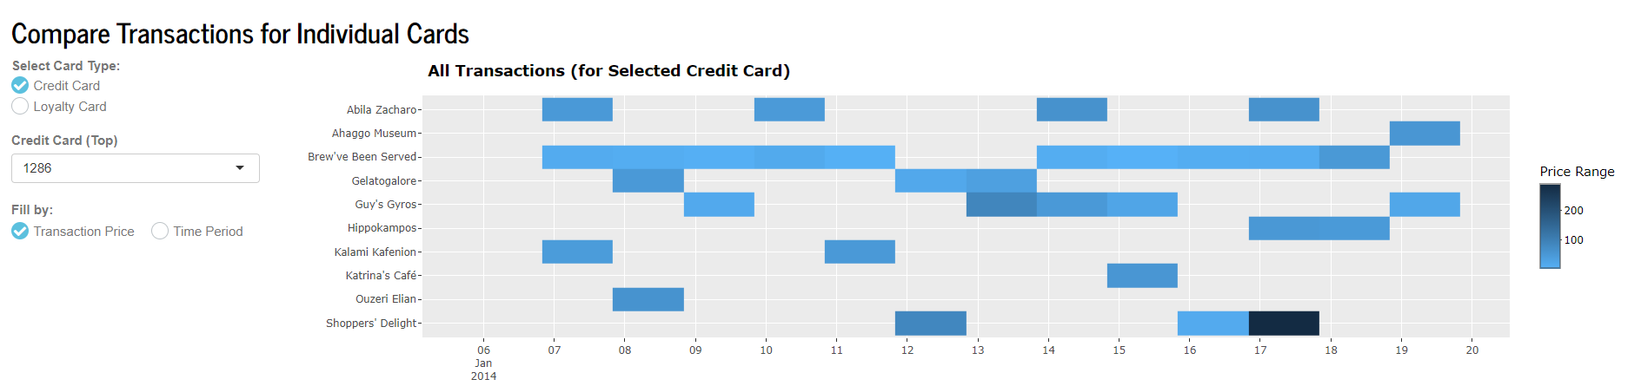
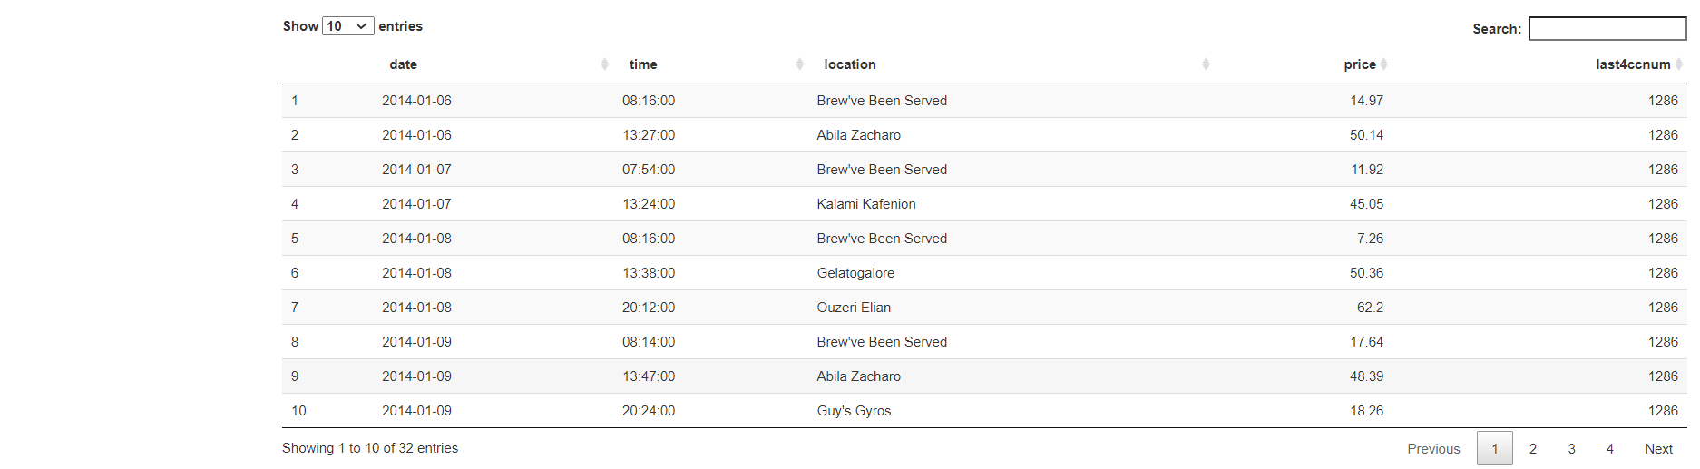
Individual Card Transactions :: EDA
Under the tab Exploratory Data Analysis, select Individual Card Transactions
The tile plot shows the occurrences of transactions at each location on each day over the two weeks. In this site, two workspaces are provided for users to select two different card types for comparison against each other. One plot (paired with its own data table) is at the top, one at the bottom. Hover over each tile to see the details of that transaction.
1
2
3
4
[1] Select the type of card to view the transactions for.
[2] The list of specific card numbers will appear in the dropdown list, depending on the type of card chosen.

Slide 6
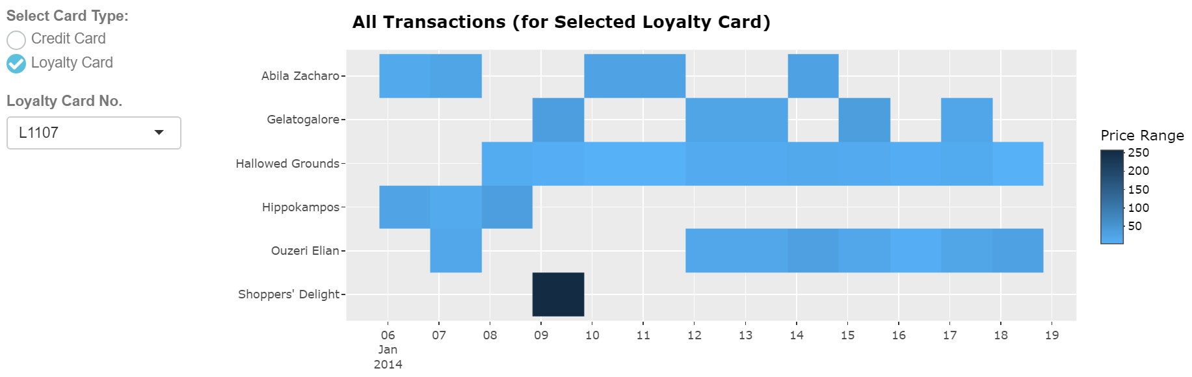
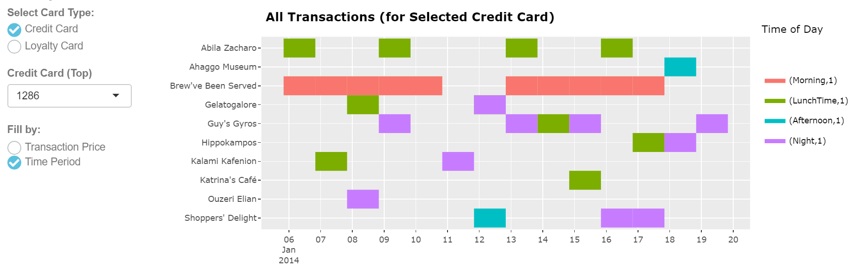
[3] If credit card is chosen, you also get to choose whether to fill the tiles according to the magnitude of their transaction amounts, or the period of day the transaction took place at. The periods are defined as follows:
Morning : 0701 – 1000 hrs
Pre-Lunch : 1001 – 1200 hrs
LunchTime : 1201 – 1430 hrs
Afternoon : 1431 – 1700 hrs
Evening : 1701 – 1900 hrs
Night : 1901 – 0000 hrs
Midnight : 0001 – 0700 hrs
[4] All transactions for the selected card will appear in the data table for further reference and analysis. Filtering and sorting can be done in the data table.
Plot for Loyalty Card
Plot for Credit Card, Fill by Time Period

Slide 7
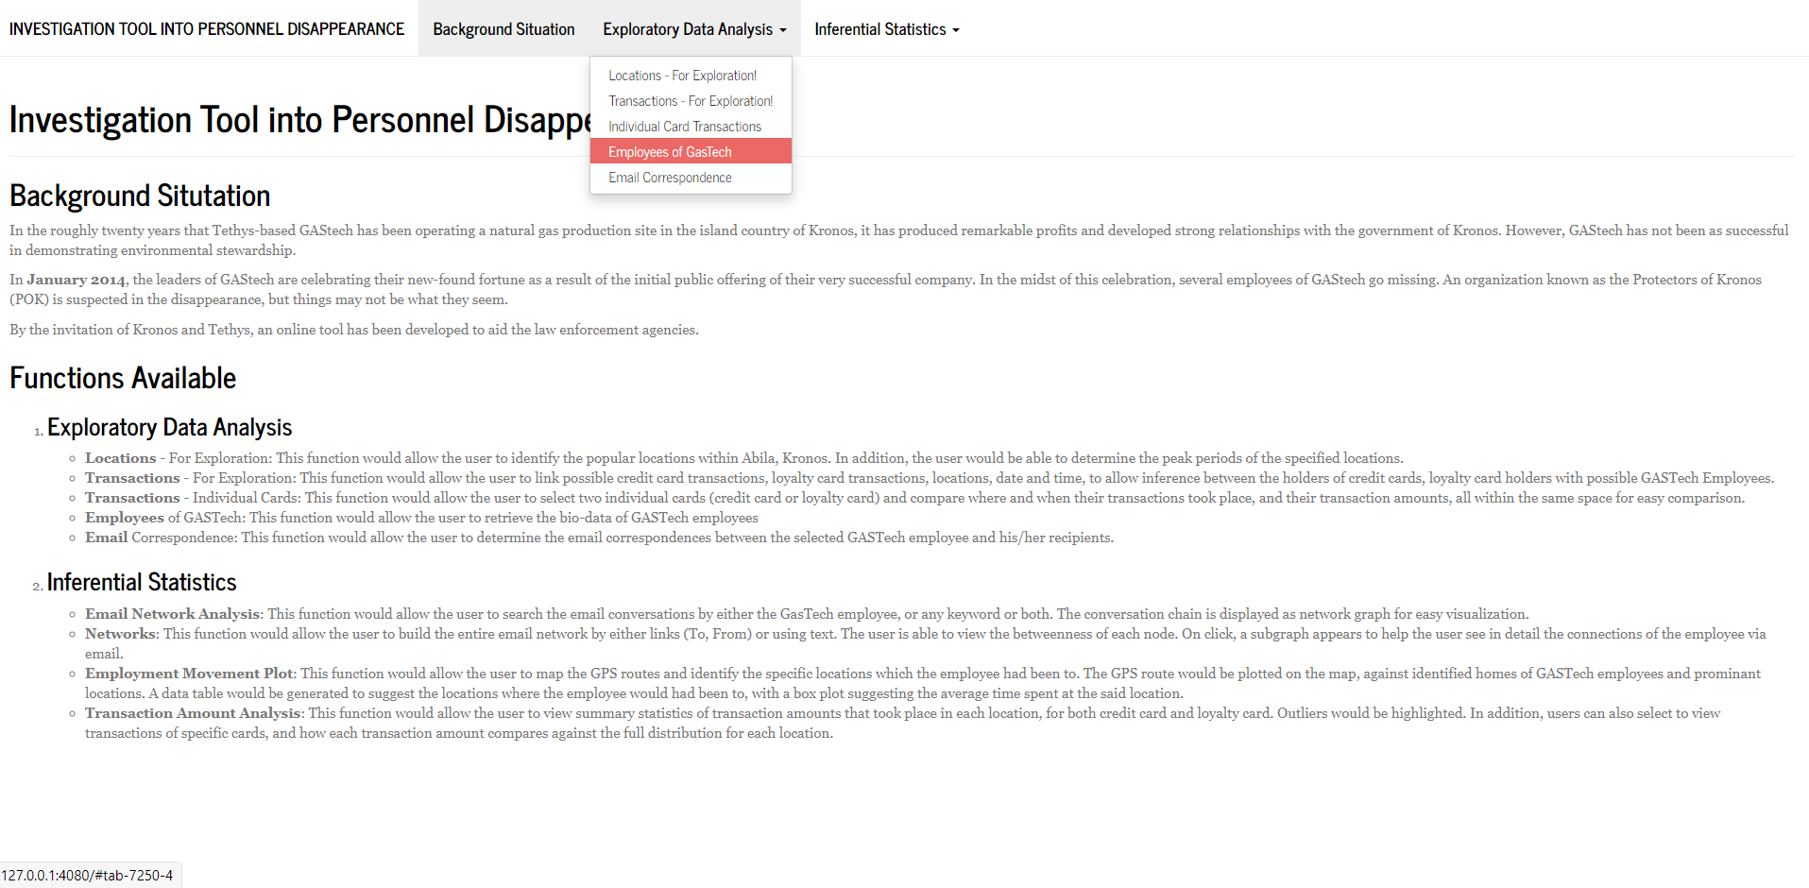
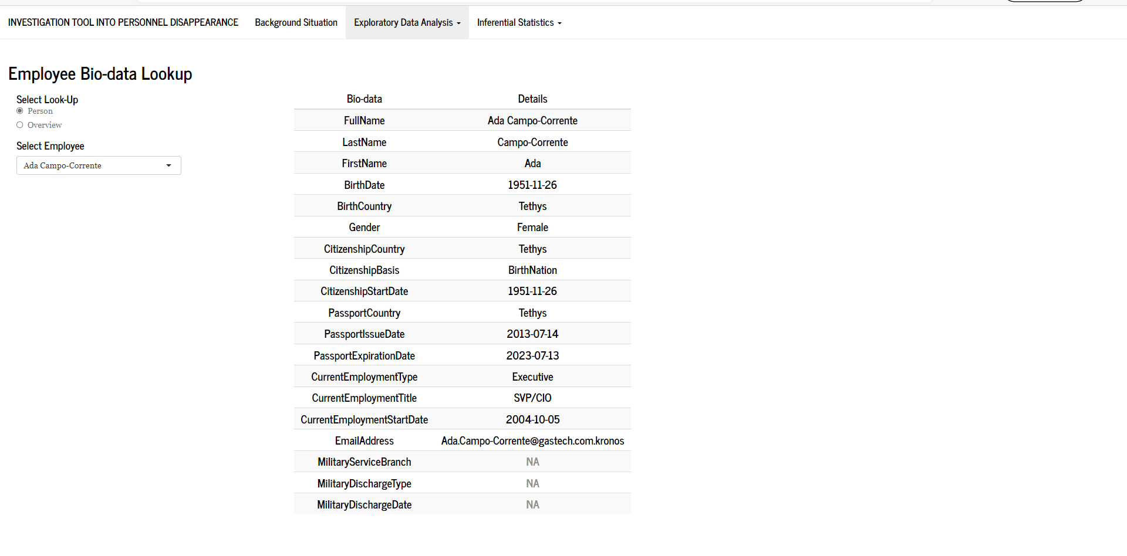
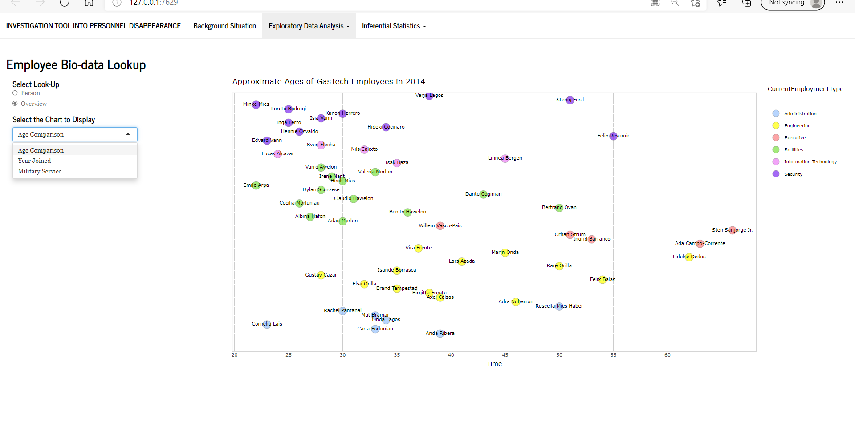
Employees of GASTech:: EDA
Under the tab Exploratory Data Analysis, select Employees of GasTech
1
2
[1] Select the Person button
[2] Select the Employee from the drop-down menu to view their biodata page
3
4
[3] Select the Overview button
[4] Select one of 3 charts that display the overall biodata of all GasTech Employees

Slide 8
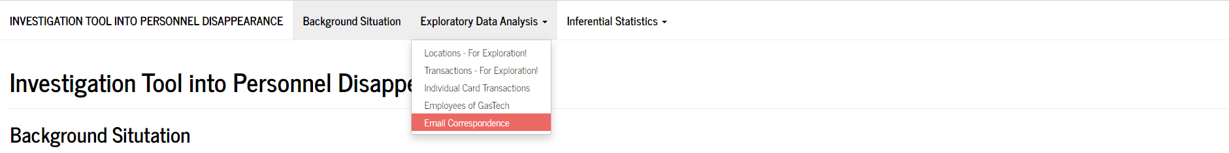
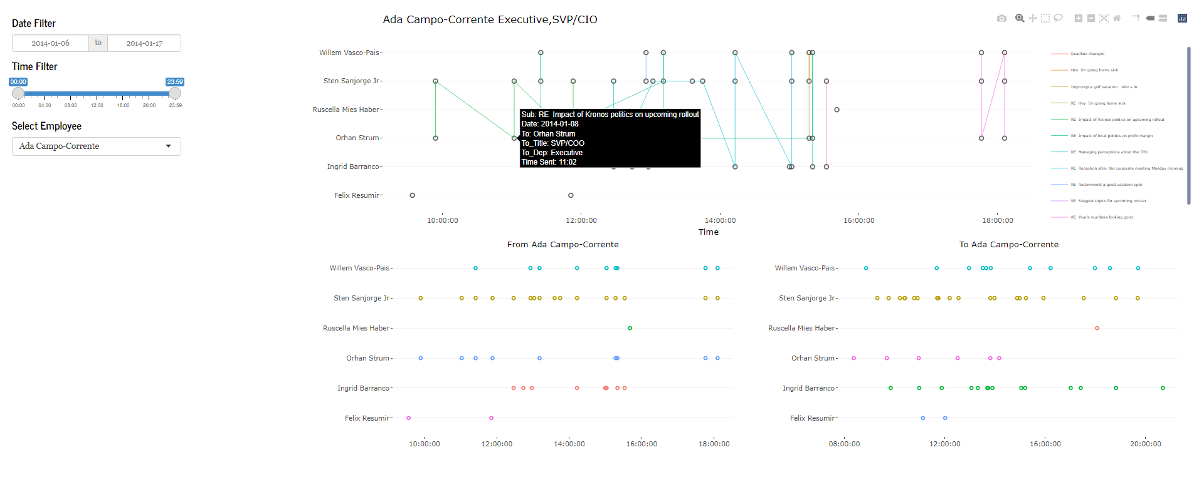
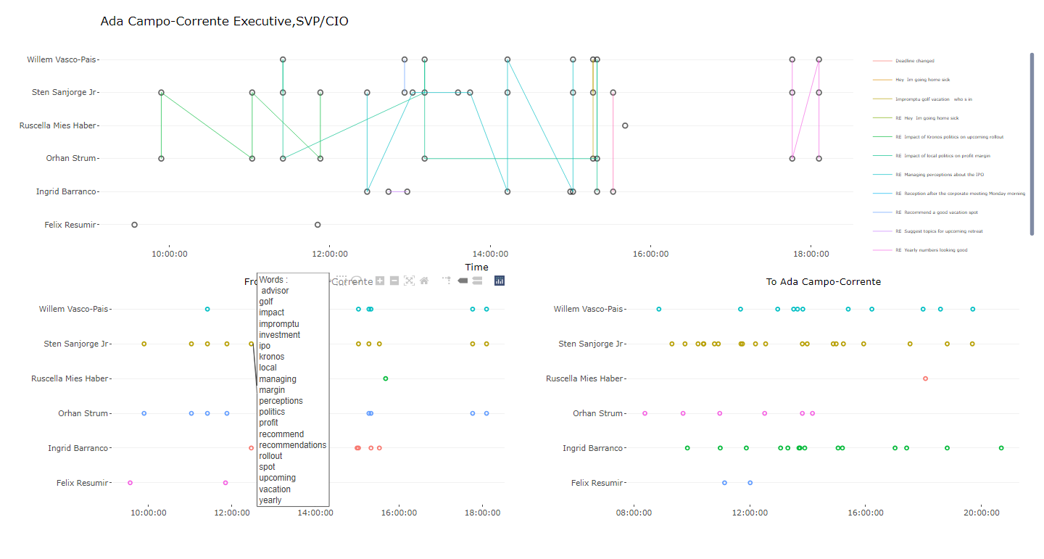
Email Correspondence:: EDA
Under the tab Exploratory Data Analysis, select Employees of GasTech
1
2
4
3
5
[1] Select the date filter
[2] Select the Time range
[3] Select the Employee from the dropdown
[4] The main chart tells us all email subjects of the employee. This includes emails to and from the employee. On hover, the tooltip shows the subject, recipient and time.
[5] These charts subcharts – To the Employee, and From the employee. On hover, we can see the collection all distinct words sent to or received by the employee on the y-axis at that particular point in time. These charts are independent of the time filters.

Slide 9
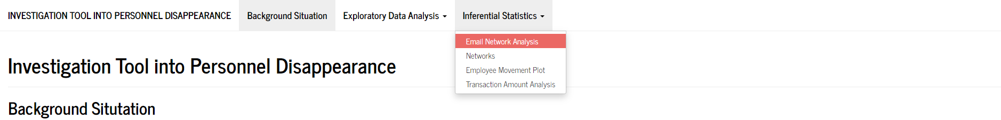
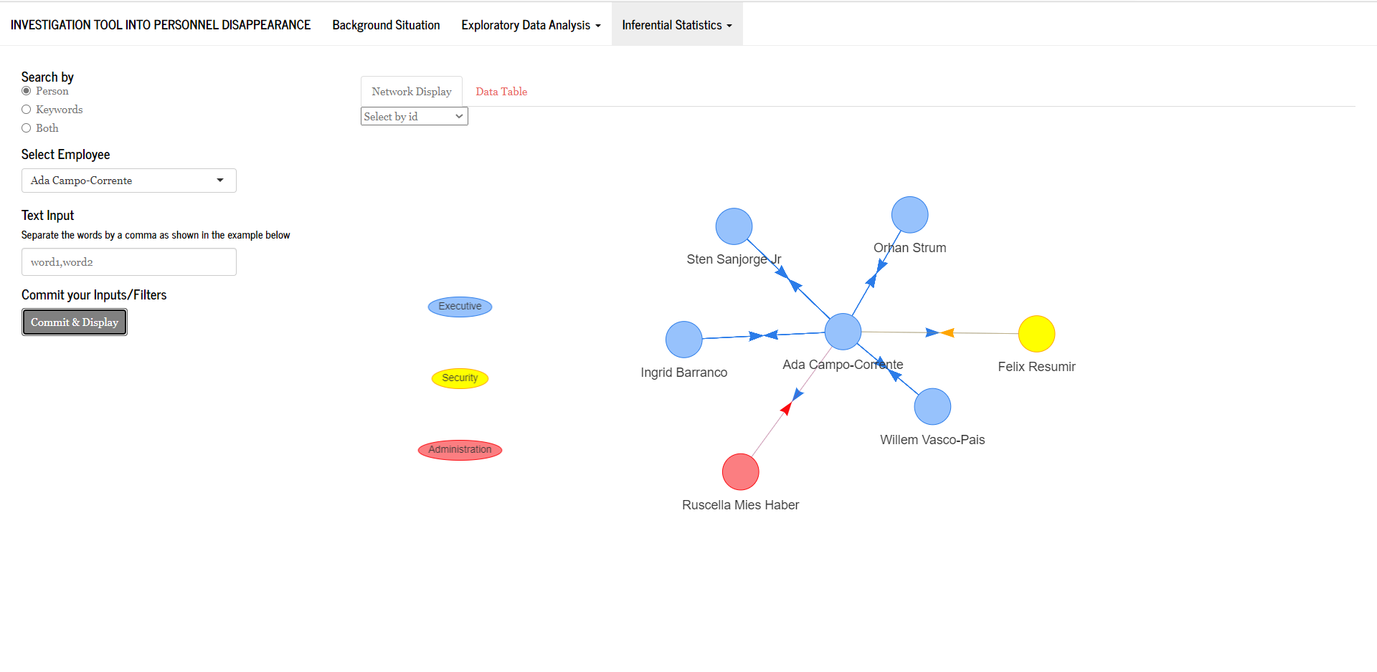
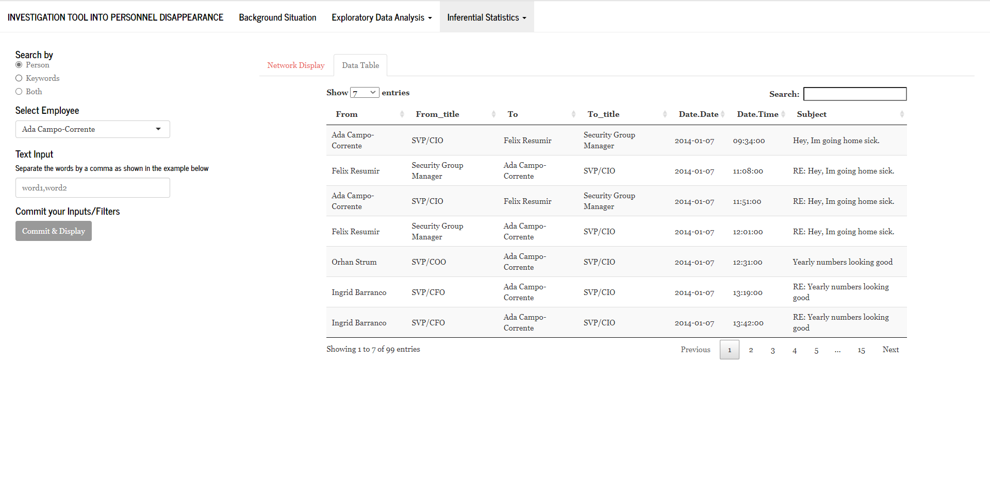
Email Network Analysis :: Inferential Statistics
Under the tab Exploratory Data Analysis, select Employees of GasTech
1
3.1
2.1
2.2
2.3
3.2
[1] Select what you wish to search the email correspondence by
[2.1] If it is by Person, select the Employee you wish to search by
[2.2] If it is by Keyword, key in the words separated by a comma with no spaces
Select Both if the search is to be done by both parameters
[2.3] Once you have confirmed the search, click on Commit & Display
[3.1] The chart on the tab 3.1 shows the visual representation of the emails that your search brought up.
[3.2] The data table on the next tab is a break down the visual.
Each row contains the position of the employee, time and date of the email subject
Each email chain is separated into individual recipients.

Slide 10
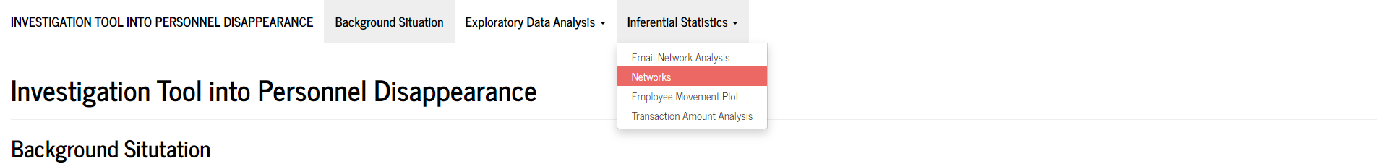
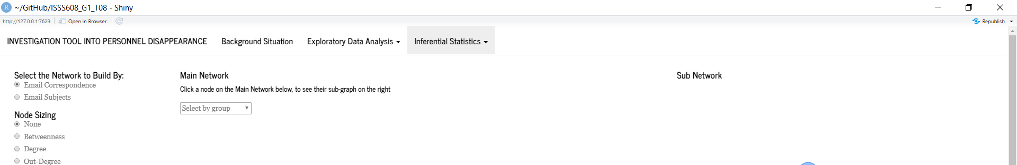
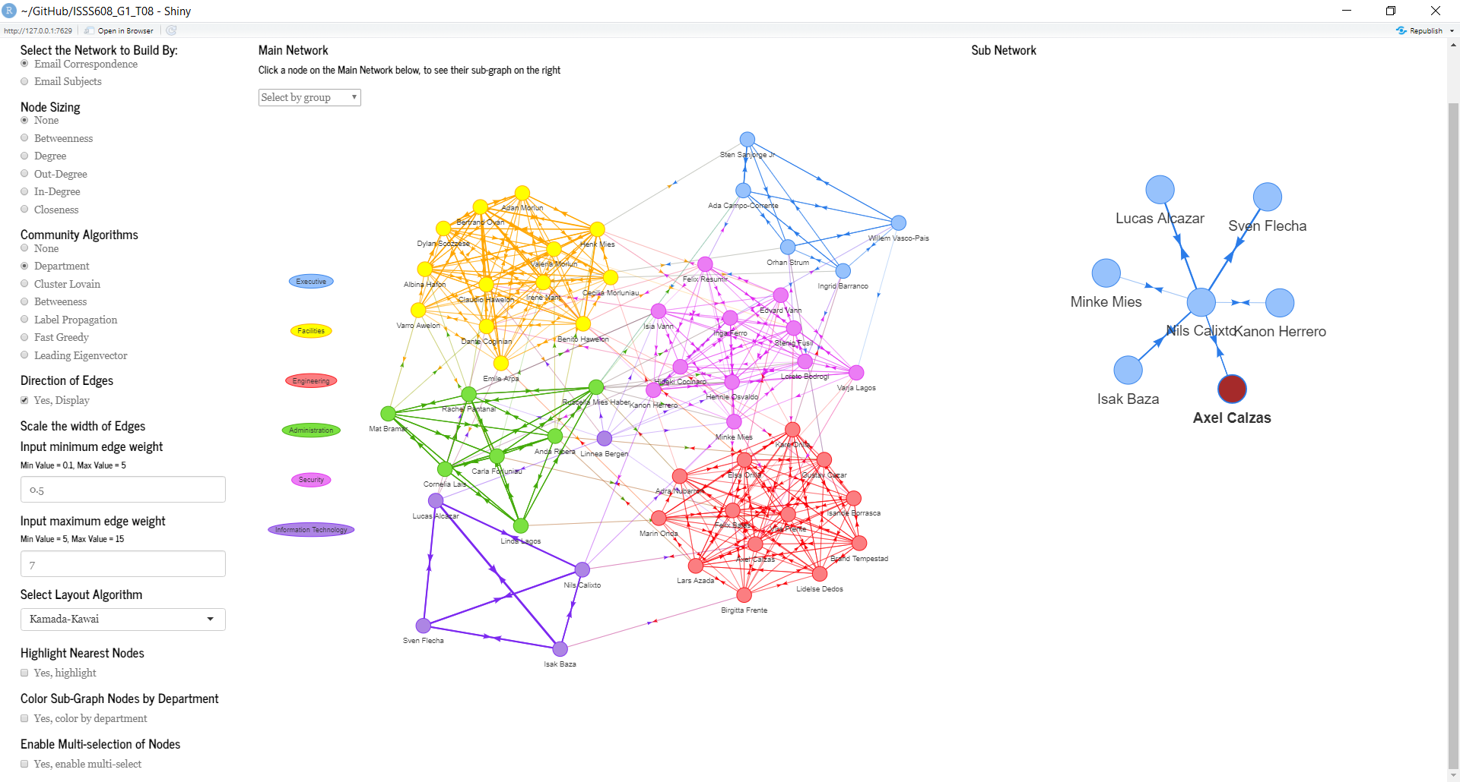
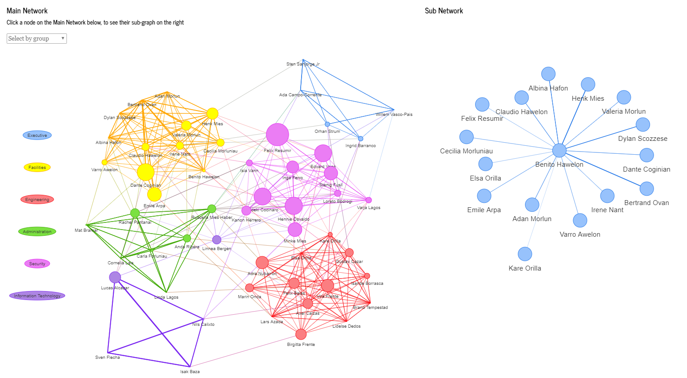
Networks :: Inferential Statistics
Under the tab Exploratory Data Analysis, select Employees of GasTech
1
2
3
1.1
1.2
4
5
6
7
8
9
[1] Select the network that you want to display. The first option, Email Correspondence plots the email links between the employees of the GasTech. The second option, plots the text network.
[1.1] The subgraph is generated on click. Click a node you wish to explore, and it will plot the subgraph on click.
[1.2] The graphs can be re-sized using the mouse scroll.
[2] The node can be size according the various algorithms show. The example below shows the nodes sized by the betweenness algorithm. We can see that Felix Resumir has the highest betweenness in the network.

Slide 11
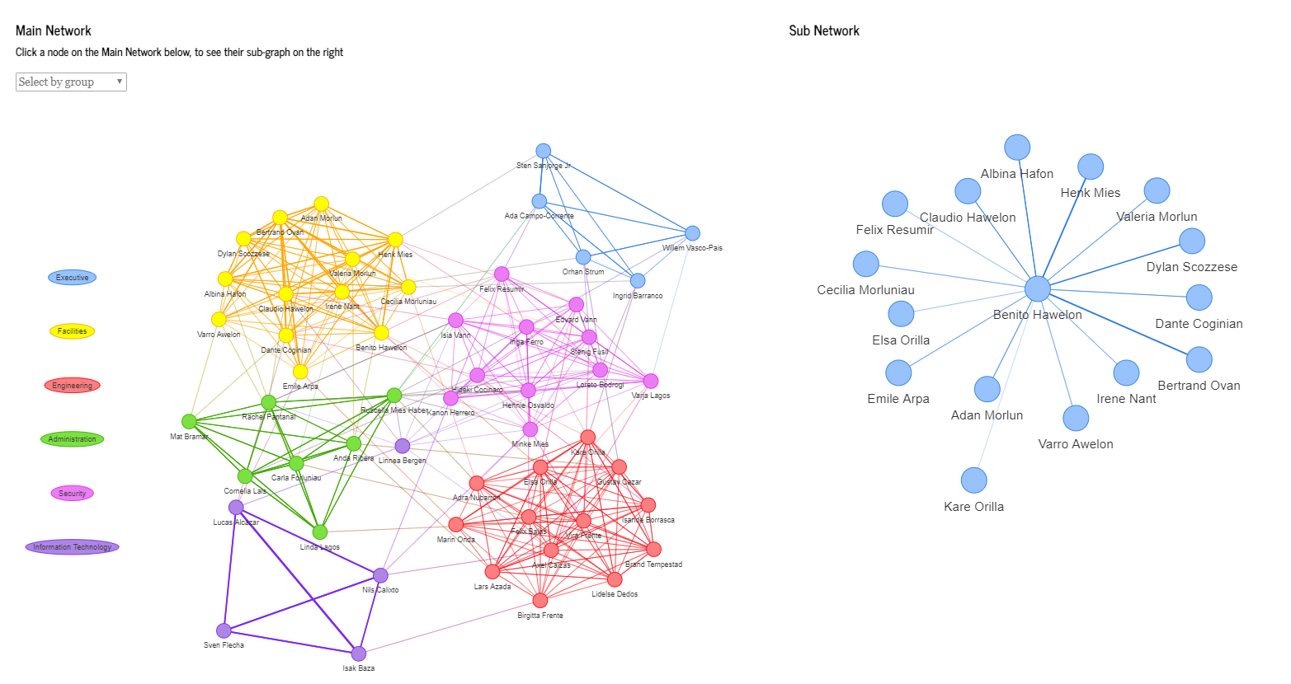
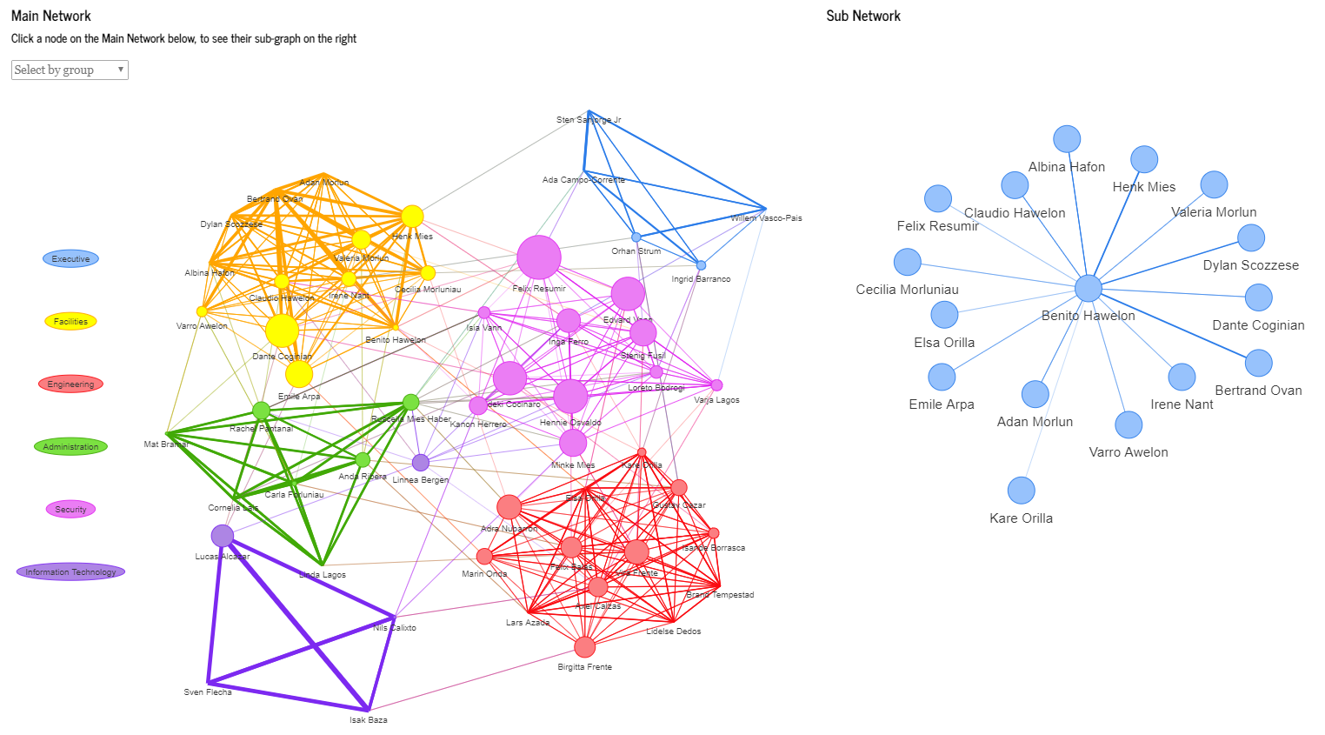
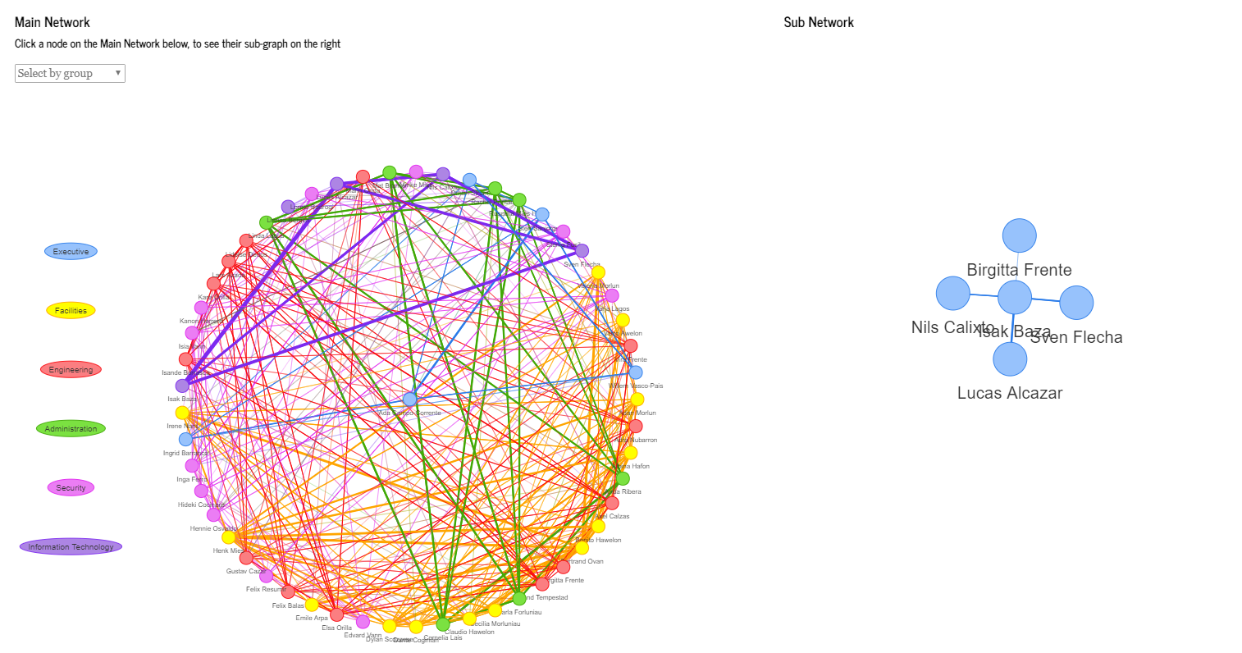
[3] The communities can be mapped by the given algorithm. Here “None” refers to the department, i.e. the nodes will be coloured by their membership in the department
.
[4] Select if the direction of the edges would like to be shown
The screenshot below shows the graph with the direction de-selected. Note that the node clicked was that of Benito Hawelon.
[5] The edges have been sized by weights i.e. the no of conversations between the employees. The default settings is set to low, but it can be increase to see employees that frequently communicate
[6] Select the Layout Algorithm. The following shows the graph with a star layout.

Slide 12
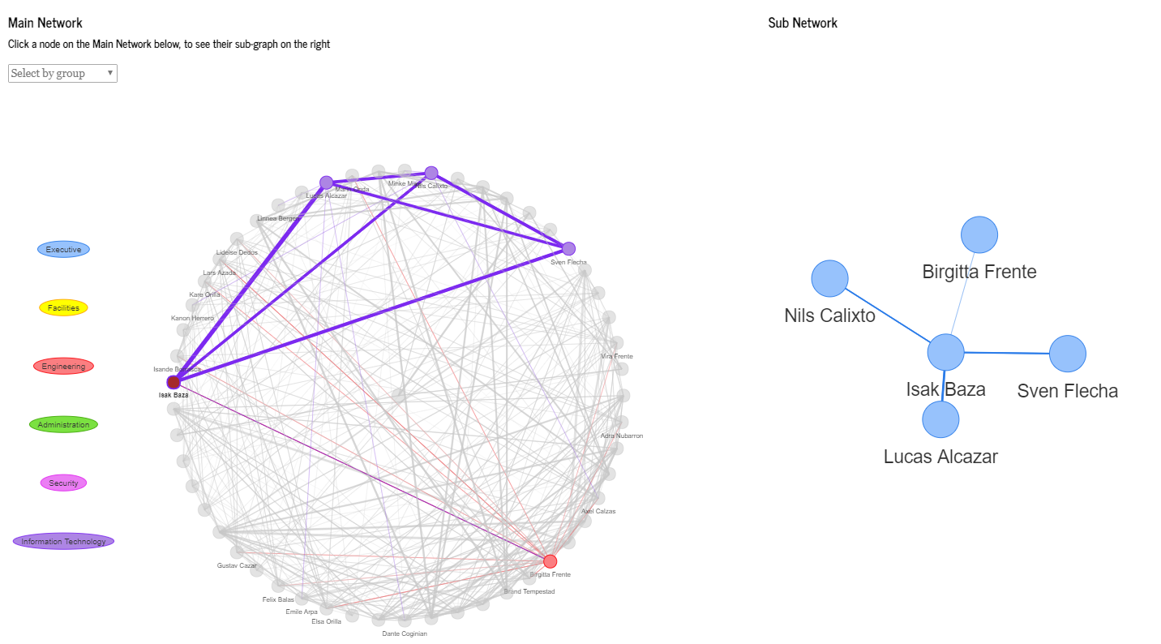
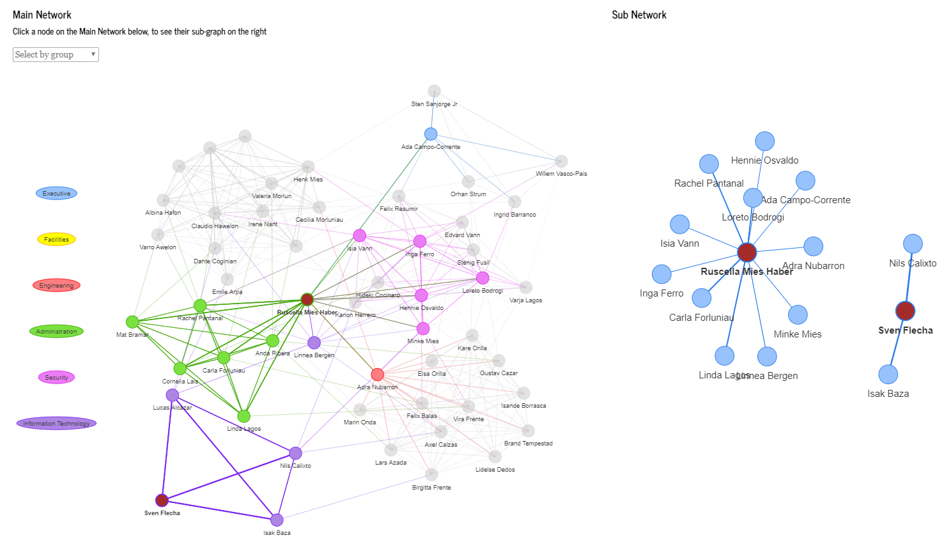
[7] Checking this box will highlight the nodes direct neighbours. The example below shows how a relatively messy layout can be made useful.
[8] The subgraphs are not colored, this option will help to color it by the department.
[9] With multiselect enabled, the user can select multiple nodes with a CTRL+click. The subgraphs will also show the central nodes and their connections selected.

Slide 13
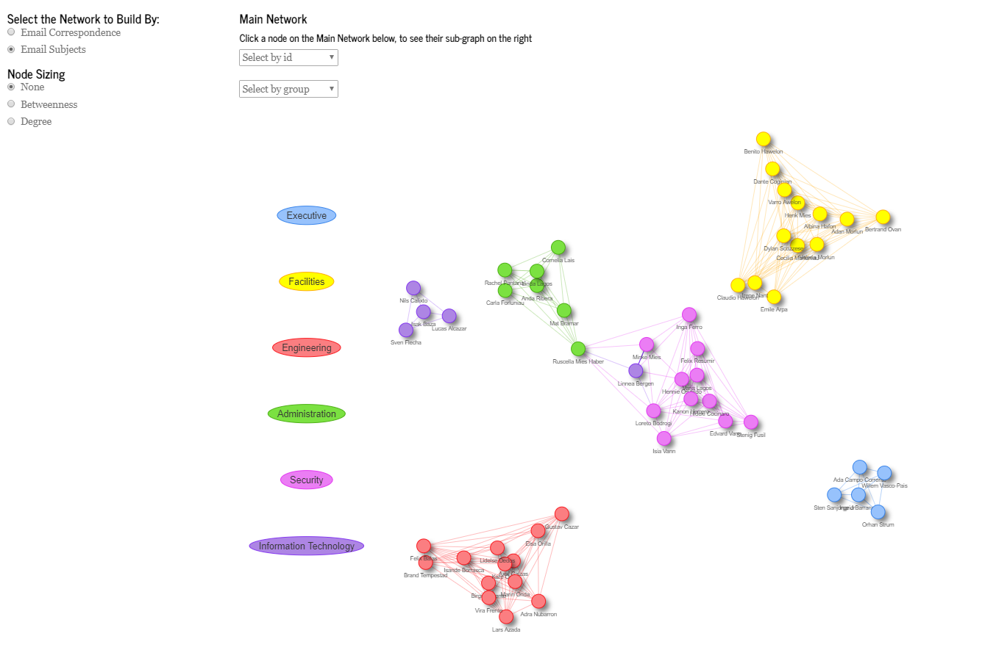
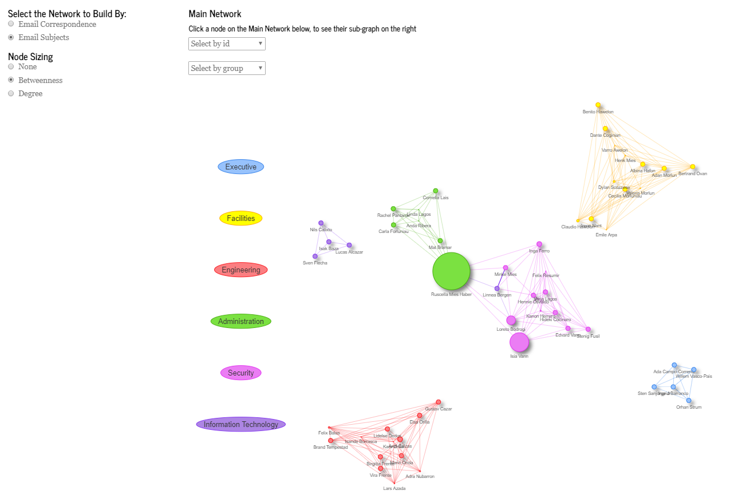
Networks :: Inferential Statistics
1
2
[1] Email Subjects will give the text network. This option will take time to load.
[2] As previously described, the nodes can be resized by 2 algorithms, degree and betweenness.

Slide 14
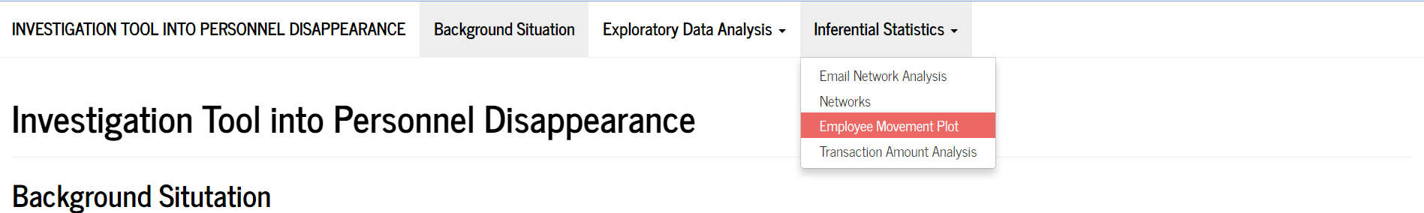
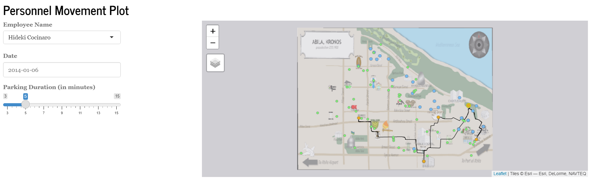
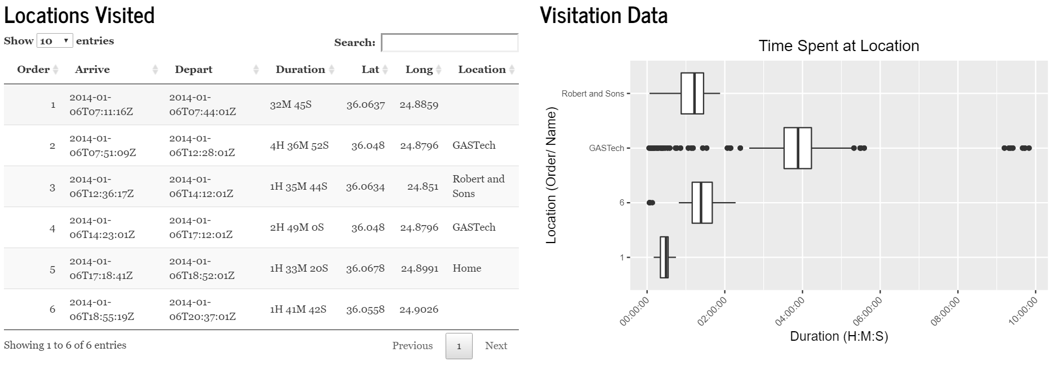
Employee Movement Plot :: Inferential Statistics
Under the tab Inferential Statistics, select Employee Movement Plot
4
1
2
3
5
6
[1] Select the GASTech Employee.
[2] Select the specific date to explore.
[3] Provide the definition for parking duration (3 – 15 mins) This would determine the number of locations he/she had been too. If 5 mins were to be selected, that would mean that any time difference of 5 mins or more would be treated as a stop..
[4] The map, with the corresponding routes would appear. Sky Blue would represent the homes of GASTech Employees, Light Green to represent locations, while the orange dot would indicate the locations that the employee had been to. The dot with a yellow backing indicates the residential home of the employee.
[5] The order of the locations would be reflected on the datatable, time of arrival, departure time and the duration he/she had spent at the location.
[6] Based on the locations listed, it would indicate the duration statistics for the locations, in the form of a box plot, to allow the investigator to infer if the stay at the location was longer than usual.

Slide 15
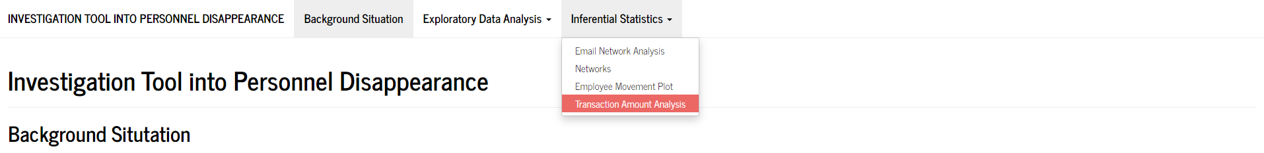
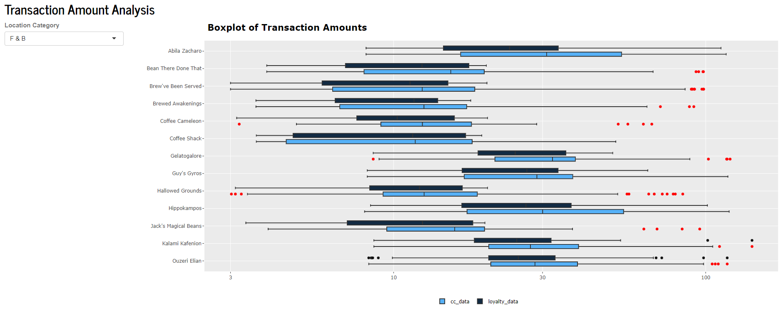
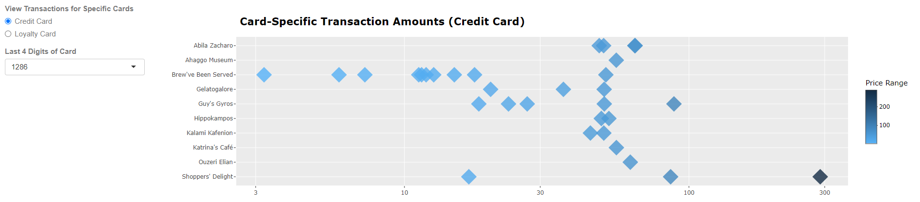
Transaction Amount Analysis :: Inferential Statistics
Under the tab Inferential Statistics, select Transaction Amount Analysis
1
2
3
4
[1] Select the category of locations you would like to display boxplots and compare the transaction amounts for. The locations are categorized so that the transactions of the same type are compared. For e.g. we can observe that for the eateries, higher amounts are spent at Abila Zacharo compared to Coffee Cameleon. Note that the x-axis is a log-scale.
[2] You may also hover along the box plots to view the distribution of each individual transaction, appearing as a tooltip. Outliers are also highlighted in red.
[3] Select the card type you want to visualize the transaction spread for, and then the card number
[4] You may hover over each diamond to view the details of the transaction. Each diamond is filled according to the magnitude of the transaction amount. Similar to the boxplot above, the x-axis is also in log-scale.

